Slide 1


SAP S/4HANA CDS, SAC Training Day 11
Anubhav Oberoy

Slide 2
Agenda – Day 11
Working with Geo maps and Account Dimension
- Understanding Exception Aggregation
- Working with GEO Maps
- Point of interest Layer using Direct file
- POI using shape file
- POI using data model
- Introduction to advance scenario
---Break---
Advance BI Scenario
- Variance Concept
- Smart Assist Scenario
- Augmented Analytics
- Smart Predict Forecast
- Smart Insight
- Smart Discovery
- Smart Grouping
- Roadmap and Support

Slide 3
We are paying salaries to employees, with SAC by far you saw that we can aggregate the data (SUM, AVG, COUNT).
Is it possible to aggregate data by a dimension.
Country | Sales
IN | 500
US | 600
IN | 900
US | 500
DE | 950
DE | 150
IN | 1000
Total sales = 500+600+900+500+950+150+1000
Average sales per country
Count of country = 3
Total Sales = 4600
Average by Country = 4600 / 3 ➔ Exception Aggregation AVG – DIMENSION = Country
SELECT AVG(salary) FROM dbtab GROUP BY country
Simple Average = Total / Count = 4600 / 7

Slide 4
Reuse Model Exception Aggregation
Why is that we added the exception aggregation (advance feature) in model, though the same calculation can be directly done in story like we did count, discount?
Story
Avg Per country
*
Model
Reusable
*
Story
Avg Per country
*
Story
Avg Per country
*

Slide 5
YTD and MTD sales
Now – 29th Oct 2023
YTD – year to date – 1st jan 2023 → 29th oct 2023
MTD – moth to date – 1st Oct 2023 → 29th Oct 2023

Slide 6

Point of interest
A point of interest layer indicates data points on a geo map like schools, hospitals, office locations etc. We can directly enrich our GEO map with either a model coordinates or from POI.
There are 3 ways we can create point of interest
Model based
File Based - dataset
Dbf and shp file based (shape file) – dataset
https://www.igismap.com/download-india-boundary-shapefile-free-states-boundary-assembly-constituencies-village-boundaries/
www.anubhavtrainings.com

Slide 7






























Slide 8











Slide 9
Advance BI Scenario
Advance BI Scenario with variance click here

Slide 10
Exception Aggregation
We want to aggregate data based on a dimension, we can use exception aggregation.
SELECT AVG(orderamount) FROM orders GROUP BY customer
2000
No. Customers = 5
2000 / 5 = 400
No Country = 20
2000 / 20 = 100
www.anubhavtrainings.com

Slide 11








Smart Assist Portfolio of SAC
Search to Insight
Smart Insights
R Visualizations
Smart Transformation
Time Series Forecasting
Smart Discovery
Smart Grouping
Deliver Simplicity through Machine Learning
Integrate machine learning seamlessly into business processes and workflows
Leverage machine learning to save time, remove complexity, and gain actionable insights
www.anubhavtrainings.com

Slide 12
Smart Assist
Search to Insight – Augmented Analytics
Allows users to use NLP (Natural Language) to command system and system can convert NL using NLP capability of machine learning and present the outputs to the user.
2. Smart Discovery
It offers a complete machine learning suite(robot) to build ENTIRE dashboard automatically with just one click, what we need to specify is the measure which we want to use to be in focus. It will also find the anomalies and unexpected hidden patterns in the data.
3. Smart Insight
Its simple, easy to use machine learning to find out most important key influencers contributing to a measure. We will also be able to drill down to these influencers.
www.anubhavtrainings.com

Slide 13
Smart Assist
4. Time Series Forecasting
Depending on past data of a measure based on time (dimension) we can find the expected value of a measure w.r.t time and deviation. SAC usage 2 in-built algorithms to predict forecast
Triple Smoothing
Linear Forecast
5. Smart Grouping
Allows us to CLUSTER data depending in groups we choose, suppose we want to segmentize the data points in multiple groups. E.g. group customers based on their ability to pay the pending bills, group students of a class in merit, demerit and mediocre.
www.anubhavtrainings.com

Slide 14
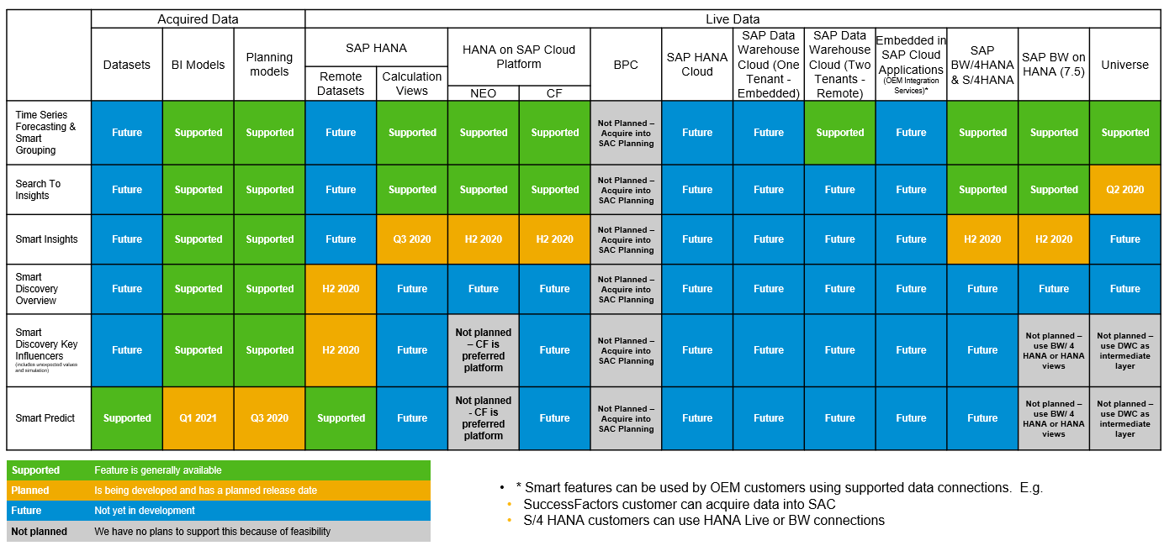
Smart Feature Support Matrix
www.anubhavtrainings.com

Slide 15




























Slide 16

Questions?

Slide 17


Thank you
Anubhav.abap@gmail.com
contact@anubhavtrainings.com
+91 84484 54549
www.anubhavtrainings.com

